Slide 1
How to give a good research talk
Dr. Khondaker A. Mamun
Director, AIMS Lab,
Professor, CSE, UIU
Extracted from
Simon Peyton Jones
Microsoft Research, Cambridge

Slide 2
Research is communication
The greatest ideas are worthless if you keep them to yourself
Your papers and talks
Crystalise your ideas
Communicate them to others
Get feedback
Build relationships

Slide 3
Do it! Do it! Do it!
Good papers and talks are a fundamental part of research excellence
Invest time
Learn skills
Practice
Write a paper, and give a talk, about
any idea,
no matter how weedy and insignificant it may seem to you

Slide 4

Giving a good talk
This presentation is about how to give a good research talk
What your talk is for
What to put in it (and what not to)
How to present it

Slide 5
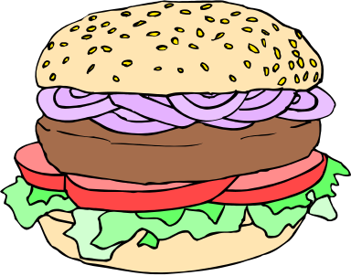

What your talk is for
Your paper = The beef
Your talk = The beef advertisment
Do not confuse the two

Slide 6

The purpose of your talk…
..is not:
To impress your audience with your brainpower
To tell them all you know about your topic
To present all the technical details

Slide 7

The purpose of your talk…
..but is:
To give your audience an intuitive feel for your idea
To make them foam at the mouth with eagerness to read your paper
To engage, excite, provoke them

Slide 8
Your audience…
The audience you would like
Have read all your earlier papers
Thoroughly understand all the relevant theory of cartesian closed endomorphic bifunctors
Are all agog to hear about the latest developments in your work
Are fresh, alert, and ready for action

Slide 9
Your actual audience…
The audience you get
Have never heard of you
Have heard of bifunctors, but wish they hadn’t
Have just had lunch and are ready for a doze
Your mission is to
WAKE THEM UP
And make them glad they did

Slide 10

What to put in

Slide 11
What to put in
Motivation (20%)
Your key idea (80%)
There is no 3

Slide 12
Motivation
You have 2 minutes to engage your audience before they start to doze
Why should I tune into this talk?
What is the problem?
Why is it an interesting problem?
Example:
Example:

Slide 13

Your key idea
If the audience remembers only one thing from your talk, what should it be?
You must identify a key idea. “What I did this summer” is No Good.
Be specific. Don’t leave your audience to figure it out for themselves.
Be absolutely specific. Say “If you remember nothing else, remember this.”
Organise your talk around this specific goal. Ruthlessly prune material that is irrelevant to this goal.

Slide 14
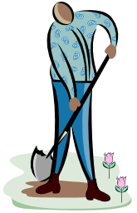
Narrow, deep beats wide, shallow
No
Yes
Avoid shallow/fluffy overviews at all costs
Cut to the chase: the technical “meat”

Slide 15
Your main weapon
Examples are your main weapon
To motivate the work
To convey the basic intuition
To illustrate The Idea in action
To show extreme cases
To highlight shortcomings
When time is short, omit the general case,
not the example

Slide 16

What to leave out

Slide 17
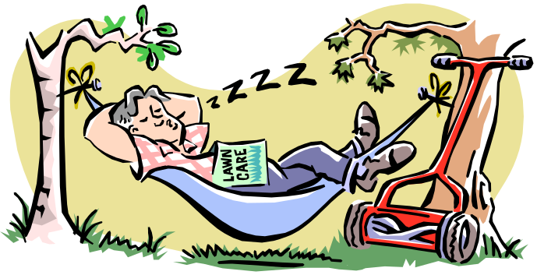
Outline of my talk
Introduction/Background
Related work
Data
Methods
results
Shortcomings
Benefits
Conclusions and further work

Slide 18
No outline!
“Outline of my talk”: conveys near zero information at the start of your talk
  But maybe put up an outline for orientation after your motivation
  …and signposts at pause points during the talk

Slide 19
Related work
[PMW83] The seminal paper
[SPZ88] First use of epimorphisms
[PN93] Application of epimorphisms to wibblification
[BXX98] Lacks full abstraction
[XXB99] Only runs on Sparc, no integration with GUI

Slide 20
Do not present related work
But
You absolutely must know the related work; respond readily to questions
Acknowledge co-authors (title slide), and pre-cursors (as you go along)
Do not disparage the opposition
  X’s very interesting work does Y; I have extended it to do Z

Slide 21
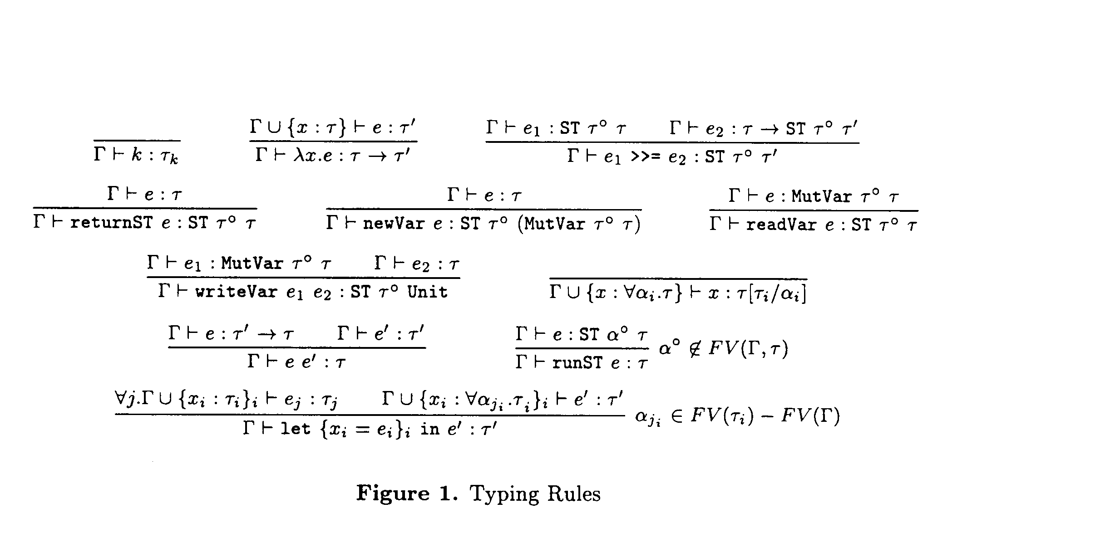
Technical detail

Slide 22
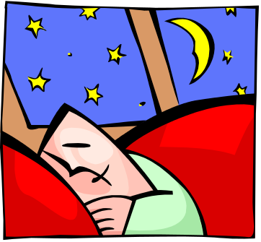
Omit technical details
Even though every line is drenched in your blood and sweat, dense clouds of notation will send your audience to sleep
Present specific aspects only;
refer to the paper for the
details
By all means have backup slides to use in response to questions

Slide 23
Do not apologise
“I didn’t have time to prepare this talk properly”
“My computer broke down, so I don’t have the results I expected”
“I don’t have time to tell you about this”
“I don’t feel qualified to address this audience”

Slide 24
Presenting your talk

Slide 25
Write your slides the night before
(…or at least, polish it then)
Your talk absolutely must be fresh in your mind
Ideas will occur to you during the conference, as you obsess on your talk during other people’s presentations

Slide 26

How to present your talk
By far the most important thing is to
be enthusiastic

Slide 27
Enthusiasm
If you do not seem excited by your idea, why should the audience be?
It wakes ‘em up
Enthusiasm makes people dramatically more receptive
It gets you loosened up, breathing, moving around

Slide 28
The jelly effect
If you are anything like me, you will experience apparently-severe pre-talk symptoms
Inability to breathe
Inability to stand up (legs give way)
Inability to operate brain

Slide 29
What to do about it
Deep breathing during previous talk
Script your first few sentences precisely
(=> no brain required)
Move around a lot, use large gestures, wave your arms, stand on chairs
Go to the loo first
You are not a wimp. Everyone feels this way.

Slide 30
Being seen, being heard
Point at the screen, not at the Computer
Speak to someone at the back of the room, even if you have a microphone on
Make eye contact
Watch audience for questions…

Slide 31
Questions
Questions are not a problem
Questions are a golden golden golden opportunity to connect with your audience
Specifically encourage questions during your talk: pause briefly now and then, ask for questions
Be prepared to truncate your talk if you run out of time. Better to connect, and not to present all your material

Slide 32

Presenting your slides
A very annoying technique
is to reveal
your points
one
by one
by one, unless…
there is a punch line

Slide 33
Presenting your slides
Use animation effects
very
very
very
very
very
very
very
sparingly

Slide 34
Finishing
Absolutely without fail,
finish on time
Audiences get restive and essentially stop listening when your time is up. Continuing is very counter productive
Simply truncate and conclude
Do not say “would you like me to go on?” (it’s hard to say “no thanks”)

Slide 35
There is hope
The general standard is so low that you don’t have to be outstanding to stand out
You will attend 50x as many talks as you give. Watch other people’s talks intelligently, and pick up ideas for what to do and what to avoid.

